Slide 1
Comparison Jersey and Apache CXF
RESTful webservices

Slide 2
License
Jersey
Apache CXF
CDDL 1.1
GPL 2 with CPE
http://jersey.java.net/
Apache License 2.0
http://www.apache.org/licenses/

Slide 3
Documentation
Jersey
Apache CXF
Good Wiki documentation
http://wikis.sun.com/display/Jersey/Overview+of+JAX-RS+1.0+Features
http://wikis.sun.com/display/Jersey/Main
Large set of examples for REST services
http://cxf.apache.org/docs/index.html
http://cxf.apache.org/docs/jax-rs.html

Slide 4
Maven support
Jersey
Apache CXF
Yes
http://jersey.java.net/nonav/documentation/latest/user-guide.html#chapter_deps
Yes
http://cxf.apache.org/docs/jax-rs.html#JAX-RS-Mavendependencies

Slide 5
OSGi support
Jersey
Apache CXF
no
Yes
Subproject „Distributed OSGi“
http://cxf.apache.org/distributed-osgi.html

Slide 6
Client API
Jersey
Apache CXF
Only http centric
Proxy based in experimental state using own annotations related to „@HypermediaController“
http://jersey.java.net/nonav/documentation/latest/experimental.html
Http centric and
Proxy based > Same interface / class as server can be used
http://cxf.apache.org/docs/jax-rs-client-api.html

Slide 7
Generated client code
Jersey
Apache CXF
???
???

Slide 8
Spring framework integration (Serverside)
Jersey
Apache CXF
Yes
Services are autodetected by component-scan
http://blogs.oracle.com/enterprisetechtips/entry/jersey_and_spring#modpom
Yes
But services have to be declared explicitly
Client: http://cxf.apache.org/docs/jax-rs-client-api.html#JAX-RSClientAPI-ConfiguringproxiesinSpring

Slide 9
Spring framework integration (client)
Jersey
Apache CXF
no
http://blogs.oracle.com/enterprisetechtips/entry/jersey_and_spring#modpom
Yes
http://cxf.apache.org/docs/jax-rs-client-api.html#JAX-RSClientAPI-ConfiguringproxiesinSpring

Slide 10
Databinding
Jersey
Apache CXF
XML
JAXB
interoperable with Apache CXFs XML translation
JSON
not interoperable with Apache CXFs JSON translation
XML
JAXB
interoperable with Jerseys XML transformation
XMLBeans
Aegis
JSON
not interoperable with Jerseys JSON translation
Does not support list and other collection interfaces
http://cxf.apache.org/docs/jax-rs-data-bindings.html

Slide 11
Security
Jersey
Apache CXF
OAuth
http://developers.sun.com/identity/reference/techart/restwebservices.html
http://www.ericonjava.com/?p=325
HTTPS
http://jersey.java.net/nonav/documentation/latest/user-guide.html#d4e784
HTTPS
http://cxf.apache.org/docs/secure-jax-rs-services.html

Slide 12
Webservice support
Jersey
Apache CXF
no
Yes
http://cxf.apache.org/docs/jax-rs-and-jax-ws.html
(Apache CXF allows to integrate into a Enterprise Service Bus concept)

Slide 13
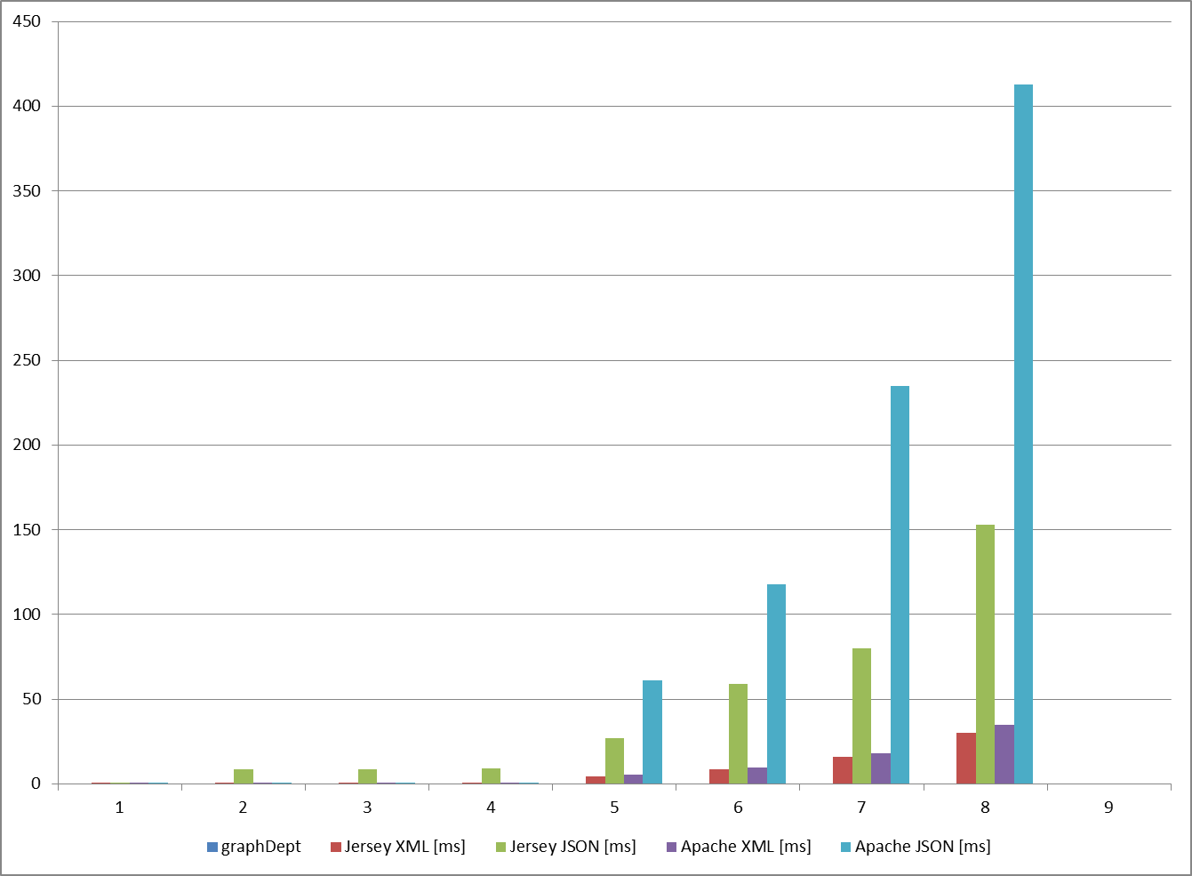
Performance Jersey-Server + Apache CXF client

